Slide 1

Master Big Data Analytics And Smart Systems
WhoDrive
A Driver Identification Framework On Automotive Grade Linux
Abdellah EL MEKKI
Supervised by:
Jury Members:
Pr. Ismail BERRADA
Pr. Mohamed EL KAMILI
Pr. Khalid FARDOUSE
Academic Year : 2017-2018

Slide 2
Timeline
1
Introduction
2
Related works
3
Proposed Driver Identification Framework
4
Results and WhoDrive Implementaion on AGL
5
WhoDrive Demonstration
6
Conclusion

Slide 3
Introduction

Slide 4
Introduction
80% of connected cars in 2020
Driving Data can be exploited in many services
Cars contain more that 400 sensors
Master Big Data Analytics And Smart Systems
02/12/2018

Slide 5
Driver Identification and Fingerprinting
Driver identification and fingerprinting is the ability of detecting who is behind the wheel without using cameras.
WHY IDENTIFING A DRIVER ?
Smart Cities Insurance Security, Anti-thief Healthcare
Master Big Data Analytics And Smart Systems
02/12/2018

Slide 6
Introduction
Related Works

Slide 7
Research | Validation technique | Features | Classification algorithms | Accuracy score
Luis and Hannen, 2017 | 70%/30% for training and testing tasks, respectively. And 10-fold cross validation | Trip duration, departure time, destination , aggressiveness level, trip type, number of events... | Random Forest, SVM, Stacking algorithms | 74 - 88%
Chowdhury et Al., 2018 | k-fold cross-validation | GPS Data + 137 statistical features | Random Forest | 82.3%
Even et Al,2015 | k-fold cross-validation 10% for validation | OBD-II data | Random Forest, SVM, KNN, Naive Bayes | 100%
Kwak et Al, 2016 | 10-fold cross validation | OBD-II data | Decision Tree, KNN, Random Forest, Multilayer perceptron | 99%
Van et Al, 2013 | 10-fold cross validation | Acceleration events, Brake events, Turning events | SVM, Kmeans clustring | 60%
Woo et Al, 2017 | 50% / 50% for training and testing tasks, respectively | Driving simulator : Steering , brake , acceleration | SVM | 70%
Martenneli et Al, 2018 | 10-fold cross validation | OBD-II data | J48, J48graft, J48consolidated, RandomTree and RepTree | 84.4% - 99.8%
Virojboonekiate et Al, 2017 | 10-fold cross validation | Acceleration data | Neural Networks | 88.3% - 92%
Fung et Al, 2017 | None | Acceleration and Deceleration Events | multiclass linear discriminant analysis | 61%
Dong et Al, 2016 | 5-fold cross-validation | GPS Data | Neural Networks: CNN, RNN | 77%
Dong et Al, 2017 | 80% / 20% for training and testing tasks , respectively | GPS Data | Autoencoder Regularized deep neural Network | 78.3%
Our Approach | Training on unique trips , validation on new unseen trips | GPS Data , OBD-II Data | CNN , LSTM | 90 – 95%

Slide 8
Challenges
Driving Data
Find real world drivesets
Find datasets containing multiple trips per driver
Car sensors generate time-series data
Identification approach
Using deep learning networks
Driving identification in a minimal time
Implantability of the framework
Automotive Grade Linux
GENIVI
NGI General Motors
Master Big Data Analytics And Smart Systems
02/12/2018

Slide 9
Proposed Driver Identification Framework
Introduction
Related Works

Slide 10
Proposed Framework
1
2
3
Data Collection
Machine Learning Classification
Driver Verification
Master Big Data Analytics And Smart Systems
02/12/2018

Slide 11
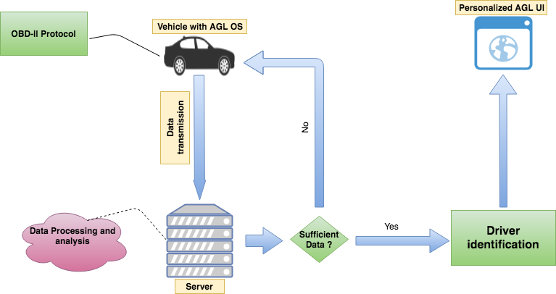
Proposed Framework
Master Big Data Analytics And Smart Systems
02/12/2018

Slide 12
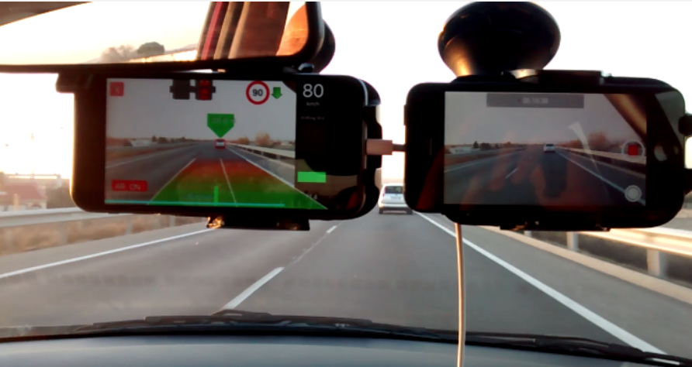
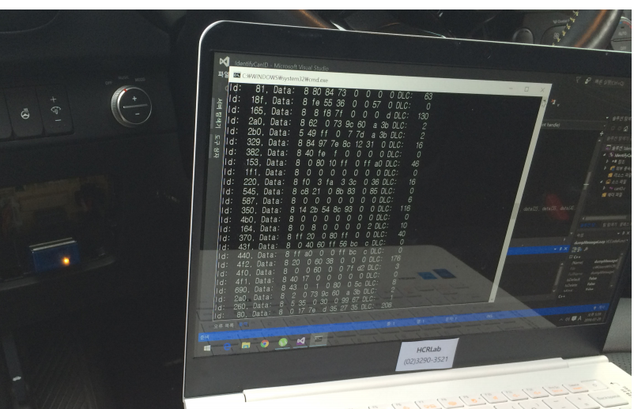
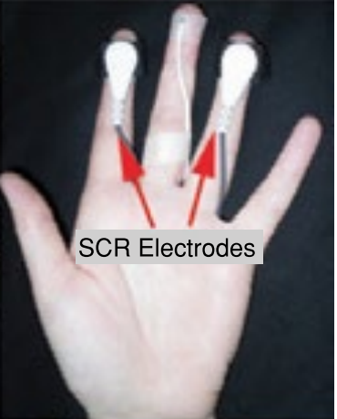
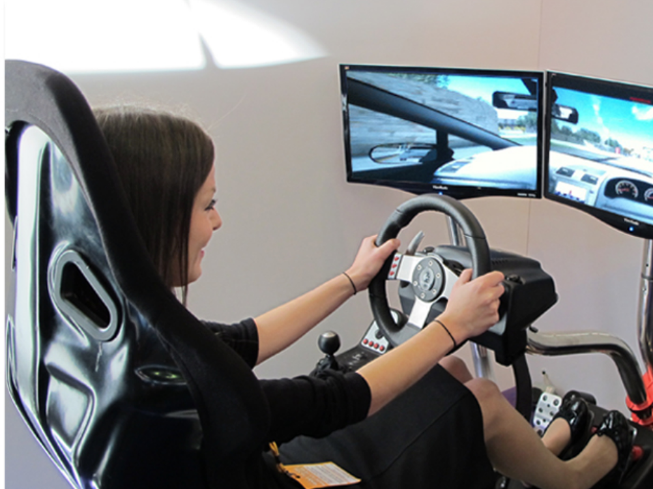
Used Datasets
10 HZ
6 Drivers
7 trips each driver
GPS Data
1Hz
10 Drivers
4 trips each driver
OBD-II Data
1024Hz
10 Drivers
1 trip each driver
GPS & Physiological data
1Hz
68 Drivers
8 trips each driver
GPS & Physiological data
UAH-Driverset
Security Dataset
HCILAB Dataset
OSF Dataset
Master Big Data Analytics And Smart Systems
02/12/2018

Slide 13
Data Preprocessing
Data Cleaning and Preparation
Window Time = 60 seconds
Sliding Windows (10 seconds)
Feature Selection
Data Normalization
Master Big Data Analytics And Smart Systems
02/12/2018

Slide 14
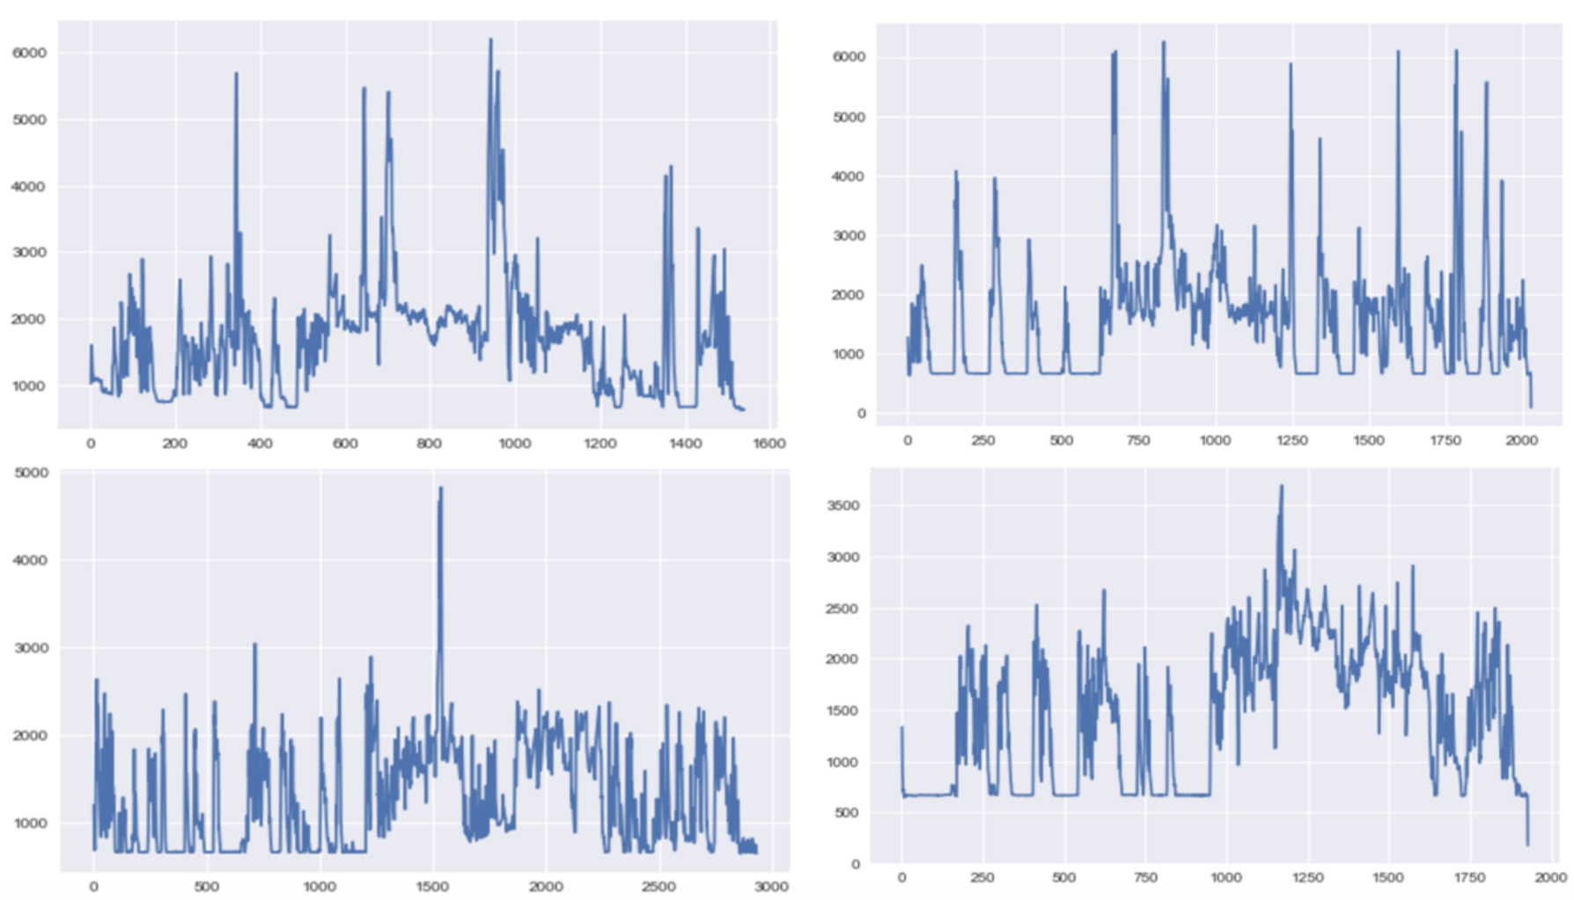
Results
Master Big Data Analytics And Smart Systems
02/12/2018

Slide 15
Results
Driver | Trips
A | A1 , A2
B | B1 , B2
C | C1 , C2
D | D1 , D2
 | Regular Cross-validation technique | Our used Cross-validation technique
Train | 80% of ( A1,A2,B1,B2,C1,C2,D1,D2) | A1,B1,C1,D1
Test | 20% of ( A1,A2,B1,B2,C1,C2,D1,D2) | A2,B2,C2,D2
Master Big Data Analytics And Smart Systems
02/12/2018

Slide 16
Used Algorithms
NoPoolCNN
Stacked RNN
1
2
CNN
FCN-LSTM
3
4
Master Big Data Analytics And Smart Systems
02/12/2018

Slide 17
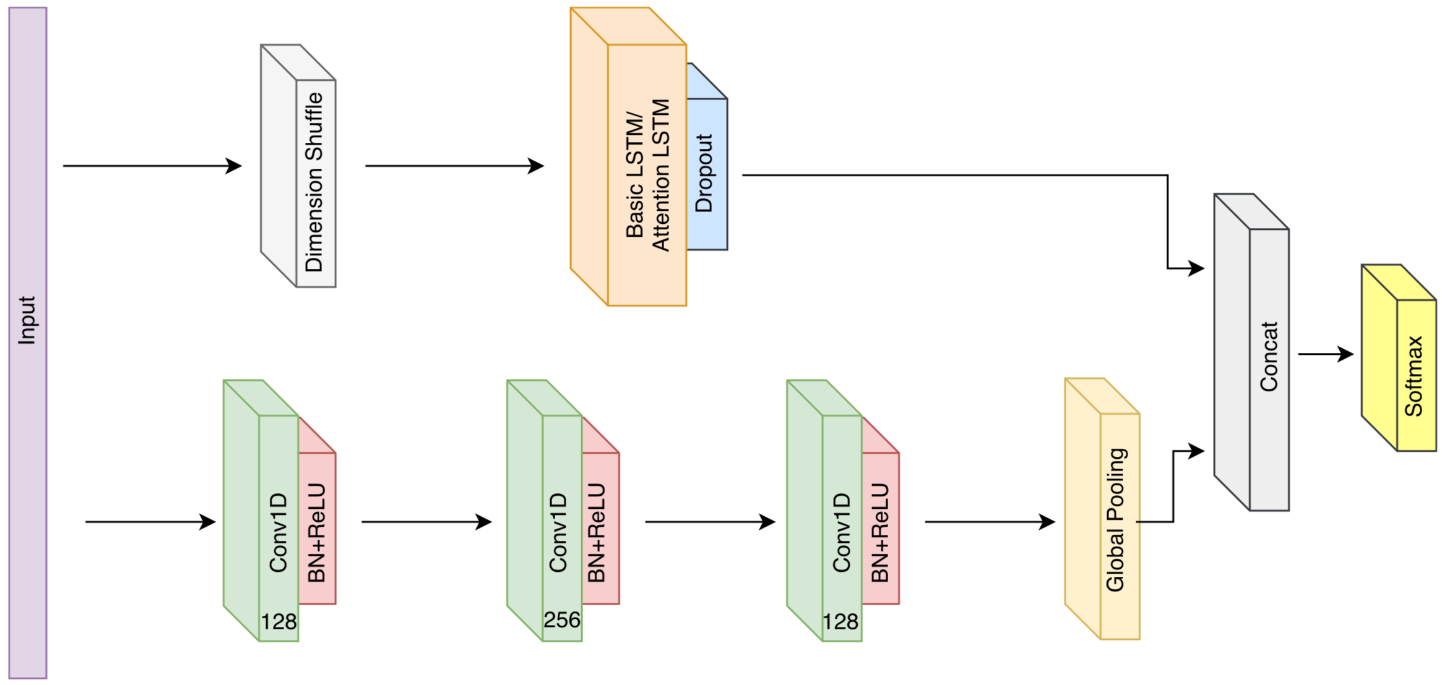
FCN-LSTM Architecture
Master Big Data Analytics And Smart Systems
02/12/2018

Slide 18
Results
 | UAH Driveset | Security Dataset | OSF Dataset | HCILAB Dataset
NoPoolCNN | 80.84% | 82.3% | 56.91% | 85.32%
StackedRNN | 25.72% | 70.42% | 35.12% | 27.19%
CNN | 87.27% | 90.04% | 58.24% | 90.53%
FCN-LSTM | 89.86% | 95.1% | 62.13% | 93.92%
Master Big Data Analytics And Smart Systems
02/12/2018

Slide 19
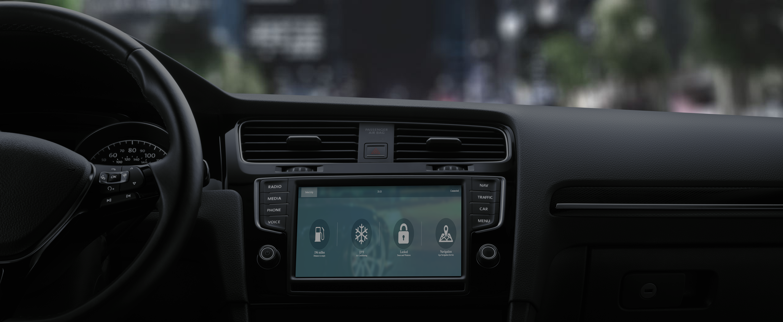
Proposed Driver Identification Framework
Introduction
Related Works
WhoDrive Implementation

Slide 20
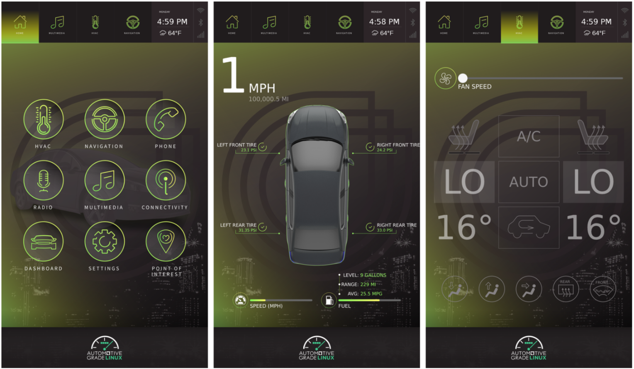
Automotive Grade Linux
Master Big Data Analytics And Smart Systems
02/12/2018

Slide 21
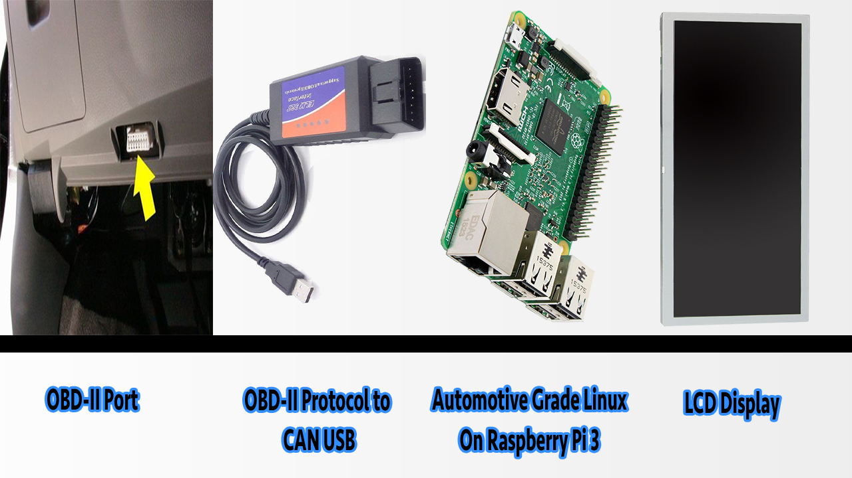
Automotive Grade Linux
OBD-II Port
OBD-II Protocol to CAN USB
Automotive Grade Linux On Raspberry Pi 3
LCD Display
Master Big Data Analytics And Smart Systems
02/12/2018

Slide 22
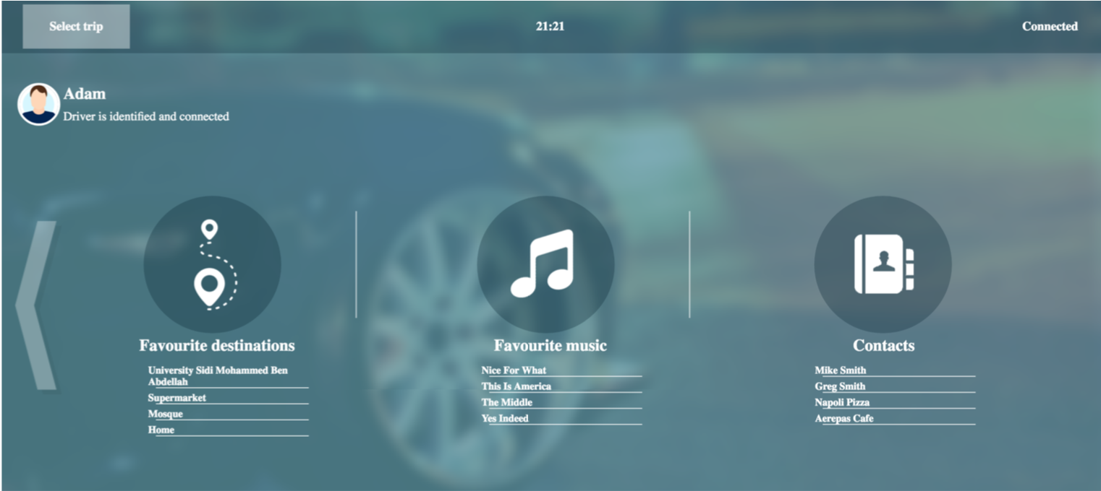
Driver Profiling System On WhoDrive
Master Big Data Analytics And Smart Systems
02/12/2018

Slide 23
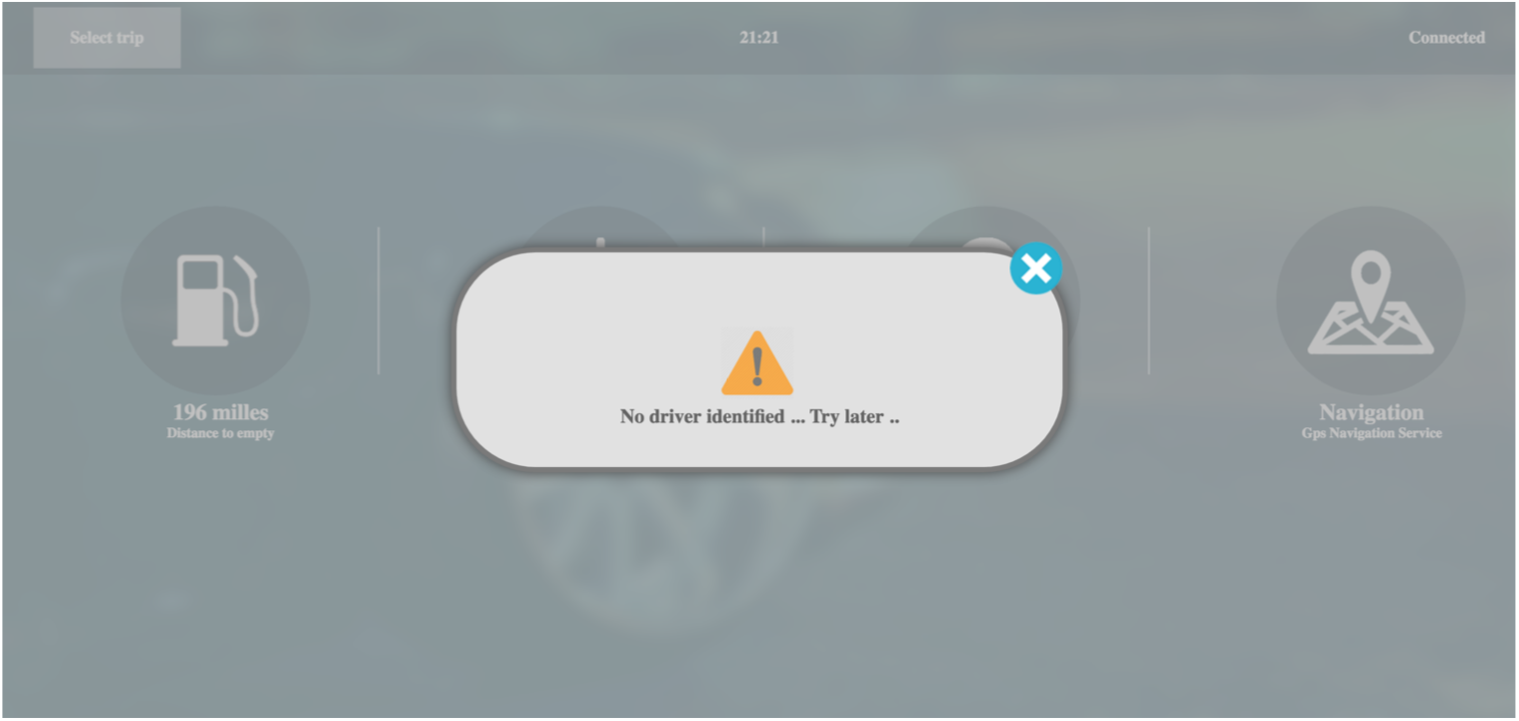
Anti-Theft System On WhoDrive
Master Big Data Analytics And Smart Systems
02/12/2018

Slide 24
Proposed driver identification Framework
Demonstration
Introduction
Related Works
Implementation

Slide 25
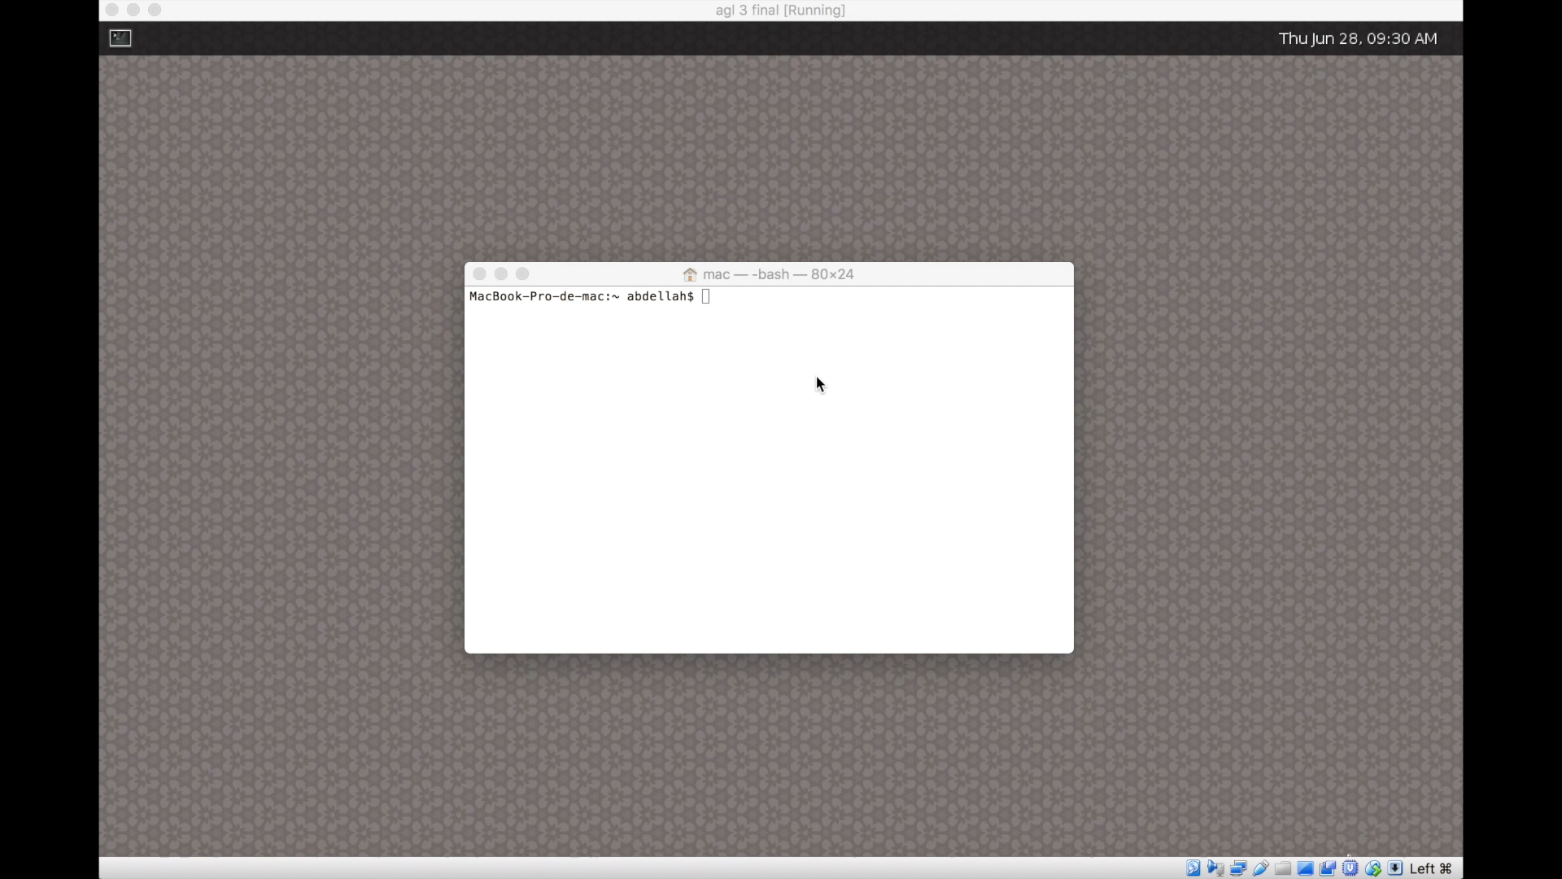

Slide 26
Conclusion And Perspectives
Optimizing the driver identification framework
Minimizing the driver identification time
Use ensembling methods to get a more stable scores
WhoDrive implementation on other Automotive Operating Systems
General Motors NGI
GENIVI
QNX
Master Big Data Analytics And Smart Systems
02/12/2018

Slide 27
THANK YOU!
ANY QUESTIONS?

Slide 28
Master Big Data Analytics And Smart Systems
WhoDrive
A Driver Identification Framework On Automotive Grade Linux
Abdellah EL MEKKI
Supervised by:
Jury Members:
Pr. Ismail BERRADA
Pr. Mohamed EL KAMILI
Pr. Khalid FARDOUSE
Academic Year : 2017-2018

